Slide 1

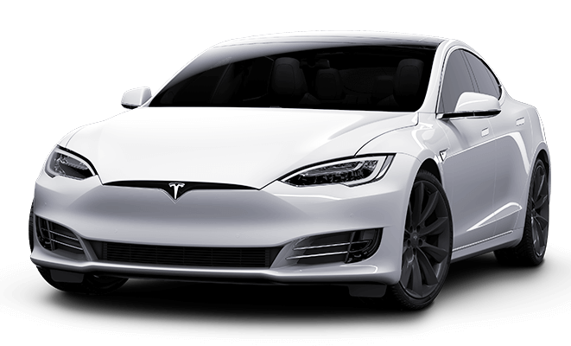
THE SUSTAINABILITY OF
ELECTRIC CARS
“
Team - C1
Figure 1 - Tesla Model S Car
http://clipart-library.com/clip-art/car-transparent-png-22.htm

Slide 2
TEAM MEMBERS
Saad Mazhar
20221804
01
Dilina Perera
20221803
“
02
Mohammed Alfar
20221802
03
Chadithya Dinuwan
20221798
04
Mohamed Juzail
20222336
05
Aakash Sathiyanathan
20222330
06

Slide 3
TABLE OF CONTENTS
01
WHAT DOES “SUSTAINABILITY OF ELECTRIC CARS” MEAN
04
ADVANTAGES & DISADVANTAGES
02
ENVIRONMENTAL IMPACT OF ELECTRIC CARS
05
SUMMARY
03
SOCIAL AND ECONOMIC SUSTAINABILITY OF ELECTRIC CARS

Slide 4

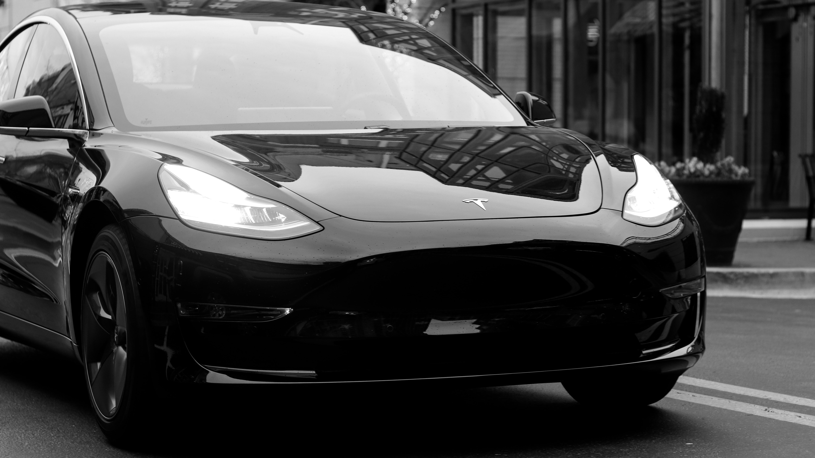

01
WHAT DOES “SUSTAINABILITY OF ELECTRIC CARS” MEAN
Figure 2 - Tesla Model 3 Car
https://unsplash.com/photos/kPUQOsfThag

Slide 5
WHAT DOES “SUSTAINABILITY OF ELECTRIC CARS” MEAN
The sustainability of electric cars is defined as their ability to reduce carbon emissions, increase energy efficiency, and support the sustainable exploitation of natural resources. The advantages and environmental effects of electric cars are evaluated in this presentation.

Slide 6
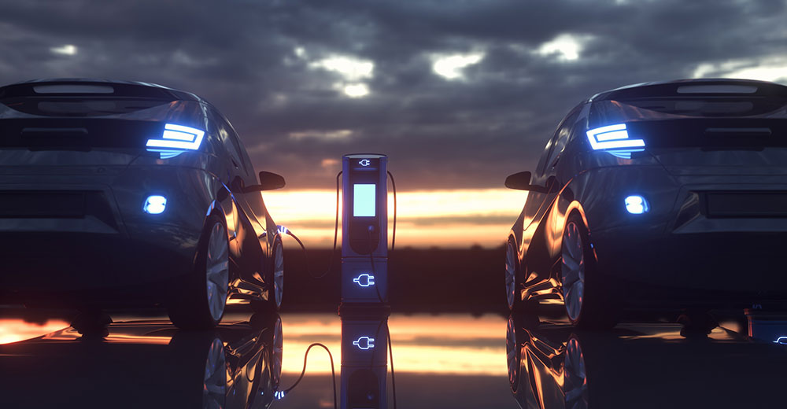
02
ENVIRONMENTAL IMPACT OF ELECTRIC CARS
Figure 3 – Two Cars Charging
https://www.counterpointresearch.com/global-ev-sales-61-q2-2022-byd-leads-market/

Slide 7
ENVIRONMENTAL IMPACT OF ELECTRIC CARS
Carbon emissions from electric cars
Electric cars are considered more environmentally friendly than conventional gasoline or diesel-powered cars, as they produce fewer carbon emissions.
Comparison with fossil-fuel cars
Electric cars emit fewer greenhouse gases and less air and noise pollutants compared to fossil fuel-powered cars.
Figure 4 – VEGA Sri-Lankan Car
https://www.vega.lk/

Slide 8
ENVIRONMENTAL IMPACT OF ELECTRIC CARS
Life cycle assessment of electric cars
A life cycle assessment (LCA) of electric cars consider the environmental impacts of battery production, electricity generation, and end-of-life disposal.
Environmental benefits of electric cars
Electric vehicles can help promote the use of renewable energy sources, lessen reliance on fossil fuels, and produce fewer emissions and pollutants than conventional vehicles.

Slide 9
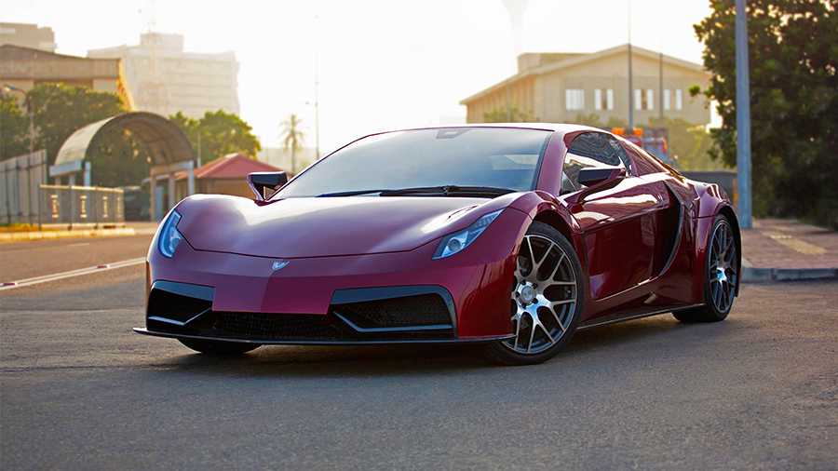
03
SOCIAL AND ECONOMIC SUSTAINABILITY OF ELECTRIC CARS
Figure 4 – VEGA Sri-Lankan Car
https://www.vega.lk/

Slide 10
SOCIAL AND ECONOMIC SUSTAINABILITY OF ELECTRIC CARS
Electric cars offer significant economic benefits, such as job creation, innovation and reduced dependence on foreign oil. The adoption of electric cars can lead to job creation in areas such as battery manufacturing, charging infrastructure installation and maintenance, and electric vehicle production.

Slide 11
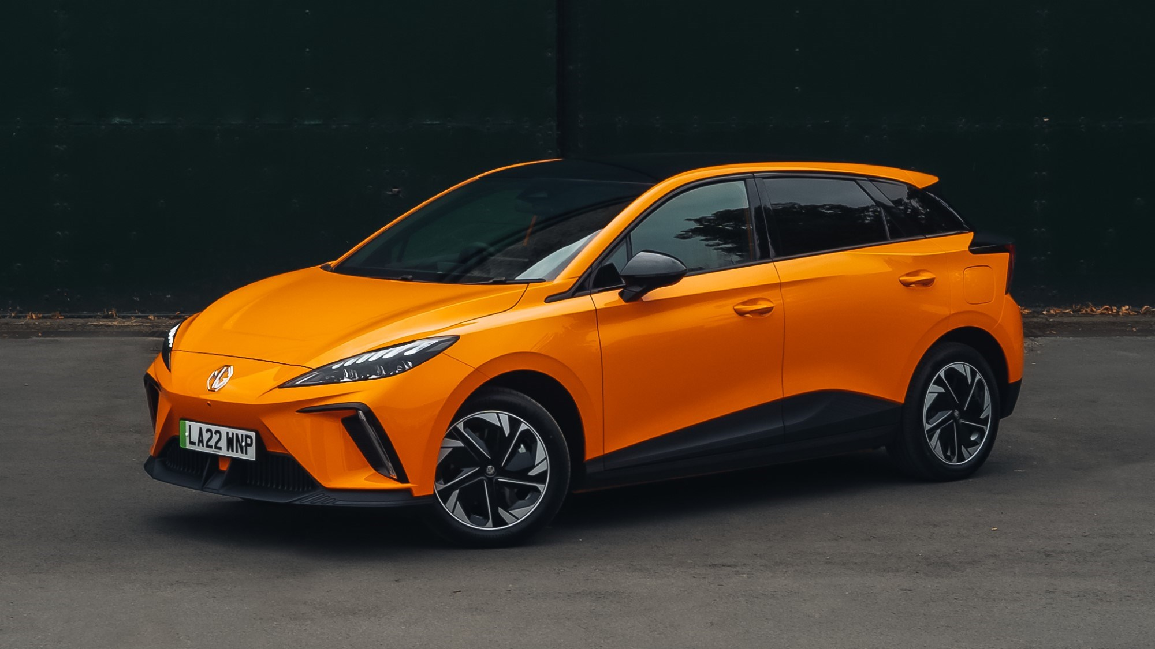
04
ADVANTAGES AND DISADVANTAGES OF USING ELECTRIC CARS
Figure 5 – MG4 EV
https://www.mg.co.uk/new-cars/mg4-ev

Slide 12
ADVANTAGES AND DISADVANTAGES OF USING ELECTRIC CARS
Advantages
Reduced environmental impact.
Lower operating costs.
Quiet and smooth driving experience.
Disadvantages
Limited driving range
Higher upfront cost
Longer charging time
Figure 4 – VEGA Sri-Lankan Car
https://www.vega.lk/

Slide 13
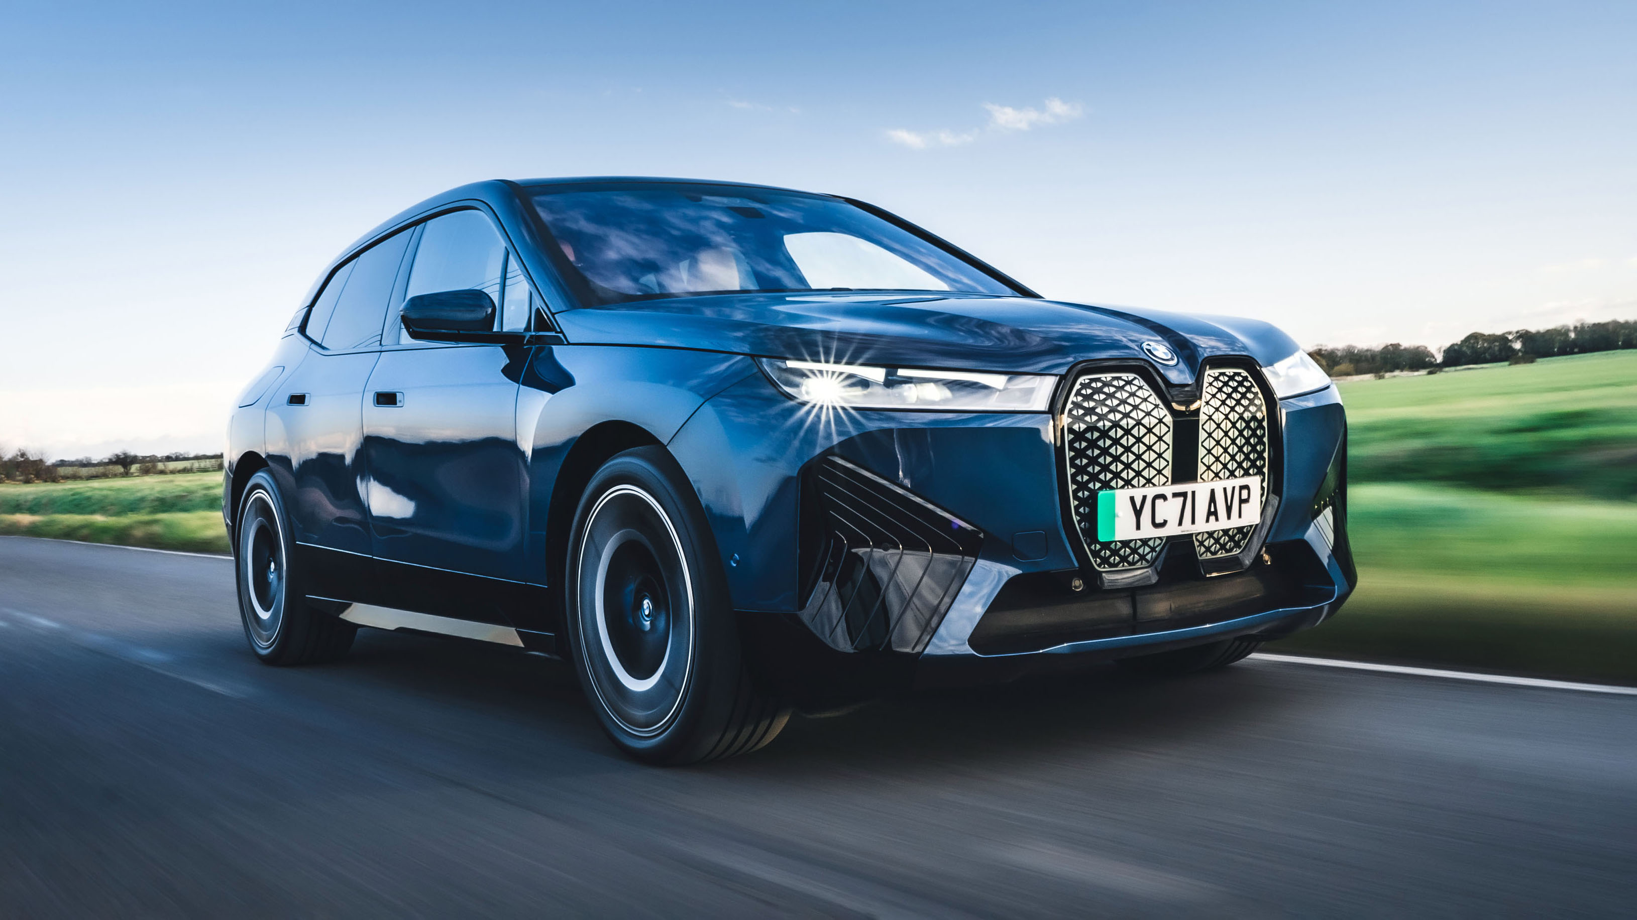
05
SUMMARY
Figure 6 – BMW iX Car
https://www.topgear.com/car-news/electric/top-gears-top-20-electric-cars

Slide 14
REFERENCES
United States Department of Energy. (n.d.). Sustainability of Electric Vehicles. Retrieved from
https://www.energy.gov/eere/electricvehicles/sustainability-electric-vehicles
[Accessed 16 Mar. 2023]
International Energy Agency. (n.d.). Electric Vehicles. Retrieved from
https://www.iea.org/topics/electric-vehicles
[Accessed 16 Mar. 2023]
National Renewable Energy Laboratory. (n.d.). Electric Vehicles. Retrieved from https://www.nrel.gov/transportation/electric-vehicles.html
[Accessed 16 Mar. 2023]
Union of Concerned Scientists. (n.d.). Electric Cars: Environmental Impact. Retrieved from https://www.ucsusa.org/resources/electric-cars-environmental-impact
[Accessed 16 Mar. 2023]
Environmental Defense Fund. (n.d.). Electric Vehicles. Retrieved from https://www.edf.org/transportation/electric-vehicles
[Accessed 16 Mar. 2023]
Car and Driver. (2021). Pros and Cons of Electric Cars. Retrieved from https://www.caranddriver.com/research/a32879456/pros-and-cons-electric-cars/
[Accessed 16 Mar. 2023]

Slide 15
REFERENCES
The Welding Institute (TWI). (n.d.). What is an EV? Frequently Asked Questions. Available at: https://www.twi-global.com/technical-knowledge/faqs/what-is-an-ev#:~:text=EVs%20are%20vehicles%20that%20are,fuels%20(petrol%20or%20diese
[Accessed 16 Mar. 2023]
Electric car. (2022). In Encyclopædia Britannica. Available at: https://www.britannica.com/technology/electric-car
[Accessed 16 Mar. 2023].
EDF Energy. (n.d.). Electric Cars and the Environment. Energywise. Available at: https://www.edfenergy.com/energywise/electric-cars-and-environment
[Accessed 16 Mar. 2023].
Renault Group. (2019, September 4). The energy efficiency of an electric car motor. News. Available at: https://www.renaultgroup.com/en/news-on-air/news/the-energy-efficiency-of-an-electric-car-motor/
[Accessed 16 Mar. 2023].
Larminie, J., & Lowry, J. (2019). Electric Vehicle Technology Explained (3rd ed.). Elsevier. Available at: https://doi.org/10.1016/B978-0-12-815801-2.00006-X
[Accessed 16 Mar. 2023].

Slide 16
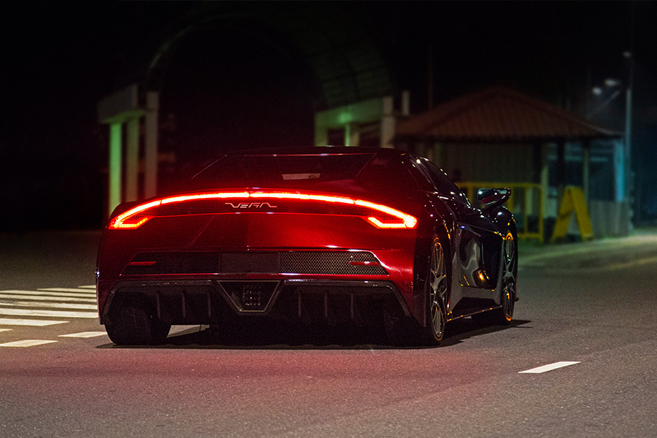
ANY QUESTIONS
Figure 7 – VEGA Sri-Lankan Car
https://www.vega.lk/

Slide 17
THANK YOU!

